Slide 1
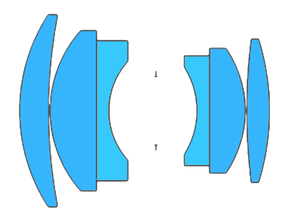

Omnifocus image synthesis using lens swivel
Indranil Sinharoy Prasanna Rangarajan Marc P. Christensen
Southern Methodist University, Dallas, TX, USA.
Imaging and Applied Optics Congress 2016

Slide 2
Problem

Slide 3
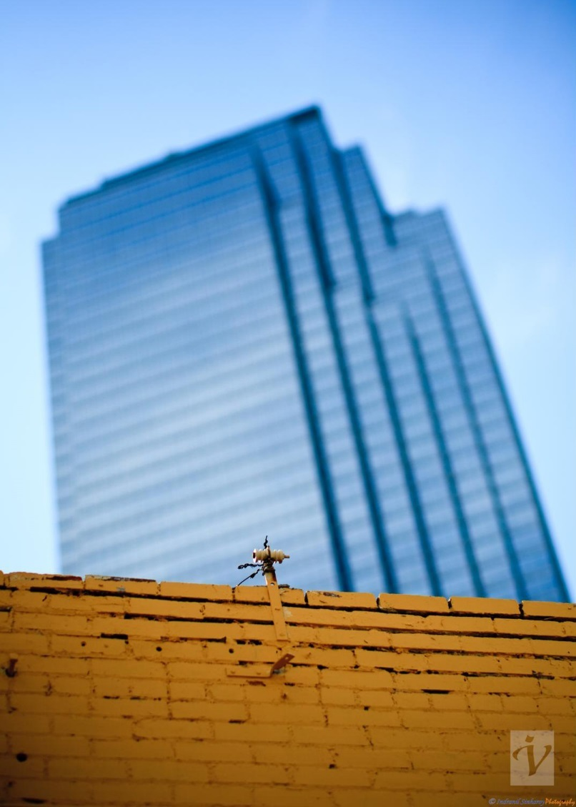
Cameras have limited Depth Of Field (DOF)
In our common experience we observe that a lens cannot focus at multiple depths in a single photograph. Out of focus objects appear blurry in the image.
Notes:
Very briefly explain why a lens cannot focus at more than one depth plane.

Slide 4
Two existing methods to extend DOF

Slide 5
Focal stacking concept
Notes:
Explain the method of focal stacking .,. Mention that this is a computational method

Slide 6
Focal stacking concept
Notes:
Explain the method of focal stacking

Slide 7
Focal stacking concept
Notes:
Explain the method of focal stacking

Slide 8
Focal stacking concept
Notes:
Explain the method of focal stacking

Slide 9
Focal stacking concept
Notes:
Explain the method of focal stacking

Slide 10
Focal stacking concept
Notes:
Explain the method of focal stacking

Slide 11
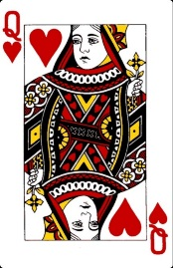
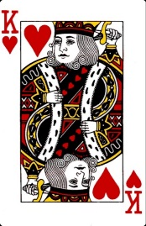
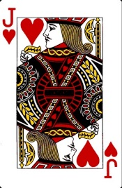

Focal stacking example
LENS
64 mm
$z$-axis
SENSOR PLANE
89 mm
200 mm
200 mm
1000 mm

Slide 12
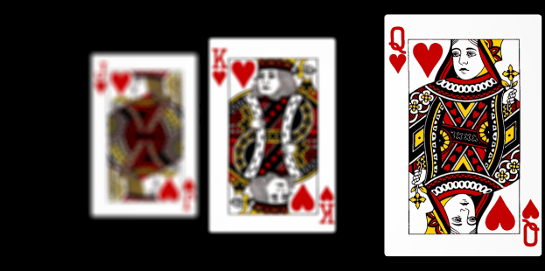
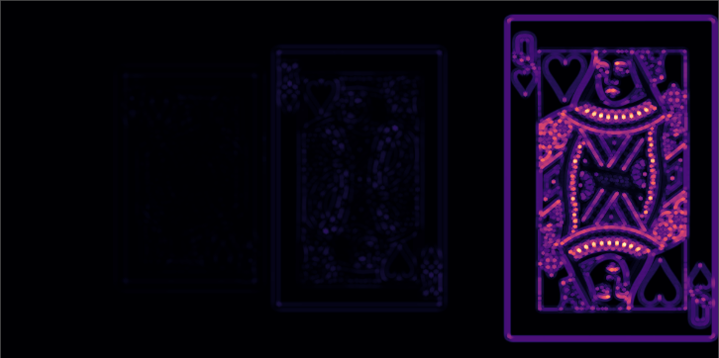
Focal stacking example
Sensor image 1/3
LENS
64 mm
$z$-axis
SENSOR PLANE
89 mm
200 mm
Focus measure (LoG)
200 mm
1000 mm

Slide 13
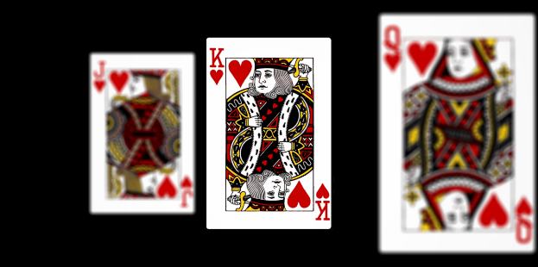
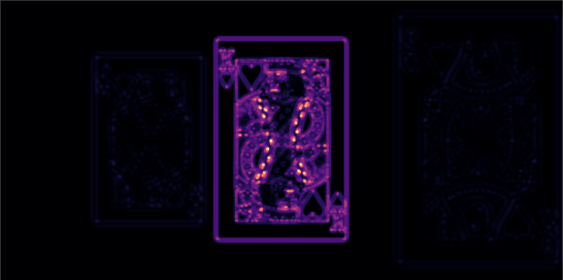
Focal stacking example
Sensor image 2/3
LENS
64 mm
$z$-axis
SENSOR PLANE
89 mm
200 mm
Focus measure (LoG)
200 mm
1000 mm

Slide 14

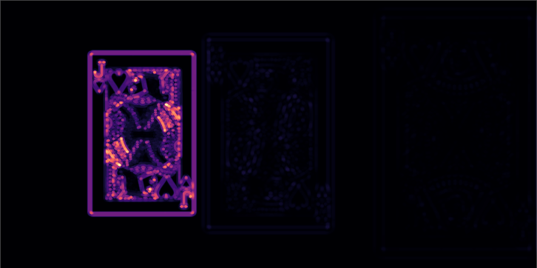
Focal stacking example
Sensor image 3/3
LENS
64 mm
$z$-axis
SENSOR PLANE
89 mm
200 mm
Focus measure (LoG)
200 mm
1000 mm

Slide 15
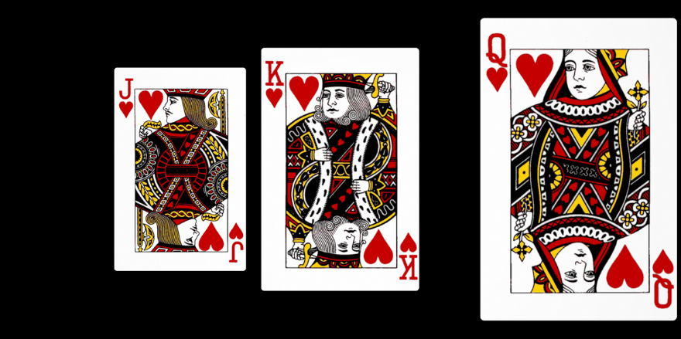
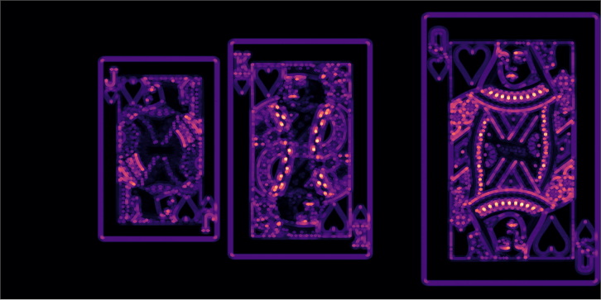
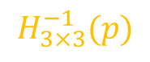
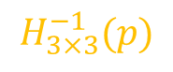
Focus stacking example
Registration
Blending
Composite image
1/2
$$H_{3×3}^{−1}(p)$$
1/2
$$H_{3×3}^{−1}(p)$$
Focus measure (LoG)
Notes:
Mention that the individual images in the stack will have different magnification.

Slide 16
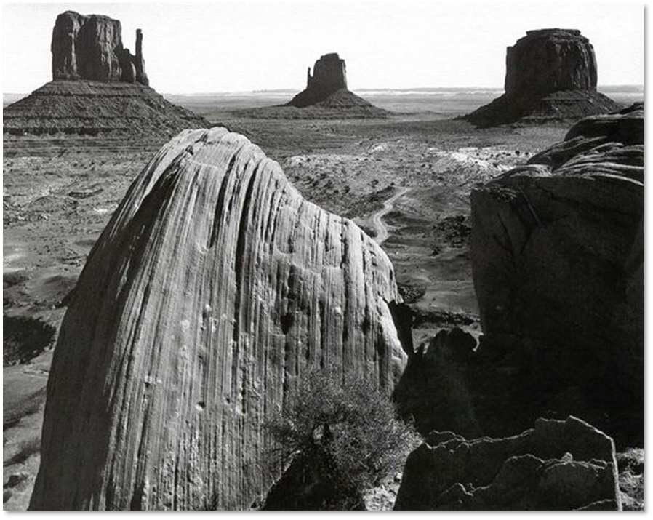
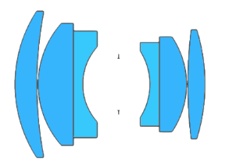
Scheimpflug imaging
Ansel Adams, Collection Center for Creative Photography, University of Arizona, © 2016
Notes:
Explain how landscape photographers use the scheimpflug principle to obtain focus on a tilted plane.

Slide 17
Proposed method

Slide 18
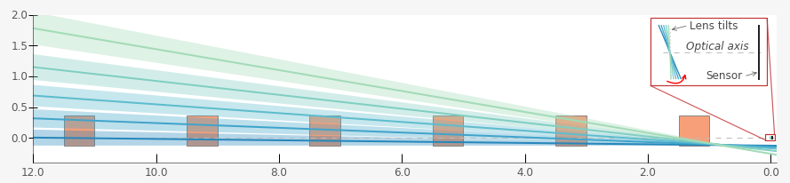
Illustration of idea

Slide 19
Illustration of idea

Slide 20
Illustration of idea

Slide 21
Illustration of idea

Slide 22
Illustration of idea

Slide 23
Illustration of idea

Slide 24
Simulation

Slide 25
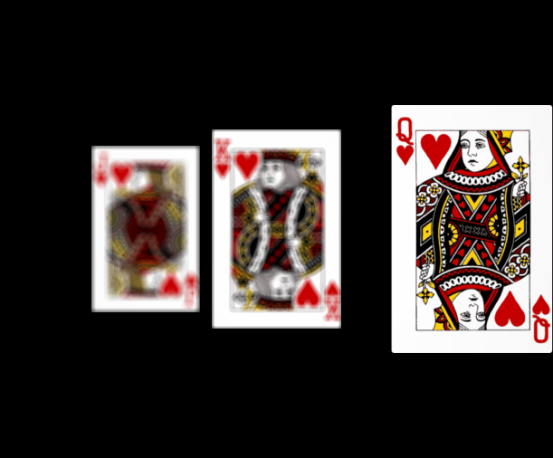
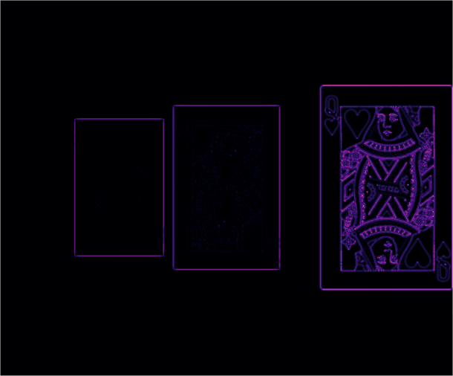
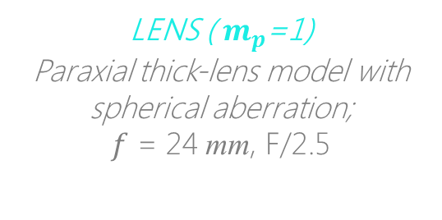

Simulation
Setup in Zemax
Sensor image 1/13 ( 0°)
LENS ( $m_{p}$=1)
Paraxial thick-lens model with spherical aberration;
$f$ = 24 mm, F/2.5
1/2
64 mm
$z$-axis
SENSOR PLANE
6 x 5 sq. mm, 1.78 $μm$
89 mm
13 tilts
between -8° & +8°
200 mm
1/2
200 mm
1000 mm
Focus measure (LoG)

Slide 26
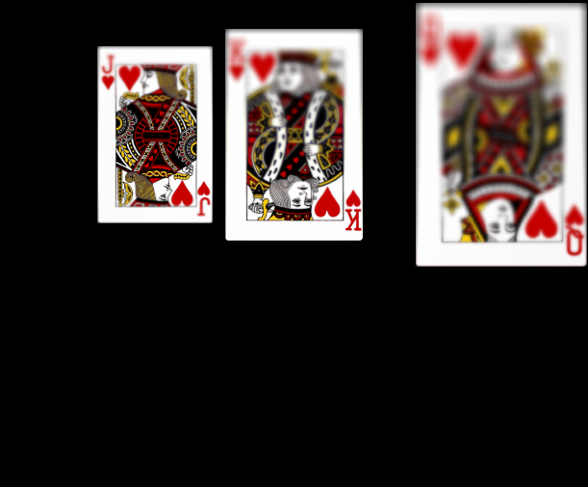
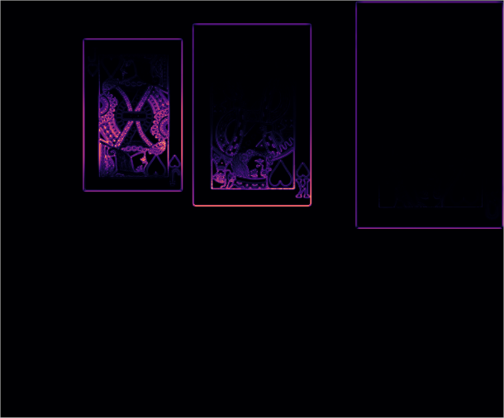

Simulation
Lens rotated by -$α$° about ENPP
Sensor image 7/13 (-8°)
LENS ( $m_{p}$=1)
Paraxial thick-lens model with spherical aberration;
$f$ = 24 mm, F/2.5
1/2
64 mm
$z$-axis
SENSOR PLANE
6 x 5 sq. mm, 1.78 $μm$
89 mm
13 tilts
between -8° & +8°
200 mm
1/2
200 mm
1000 mm
Focus measure (LoG)

Slide 27
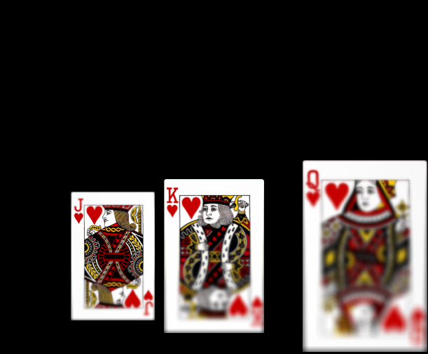
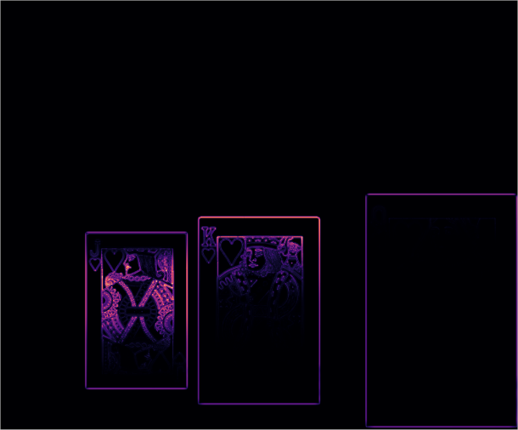

Simulation
Lens rotated by $α$° about ENPP
Sensor image 13/13 (8°)
LENS ( $m_{p}$=1)
Paraxial thick-lens model with spherical aberration;
$f$ = 24 mm, F/2.5
1/2
64 mm
$z$-axis
SENSOR PLANE
6 x 5 sq. mm, 1.78 $μm$
89 mm
13 tilts
between -8° & +8°
200 mm
1/2
200 mm
1000 mm
Focus measure (LoG)

Slide 28
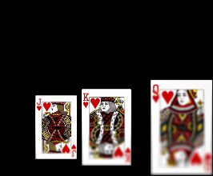
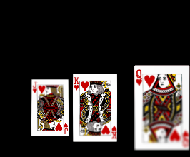
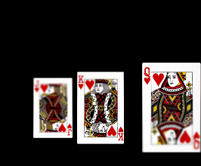
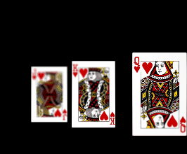
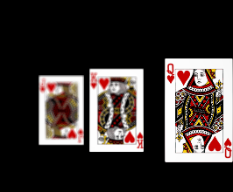
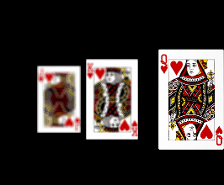
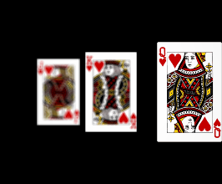
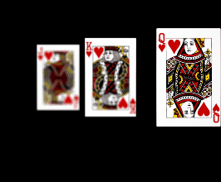
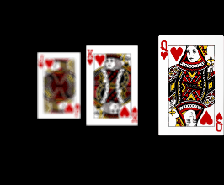
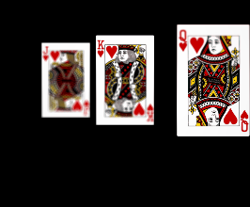
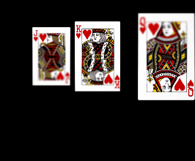
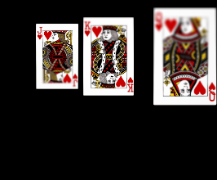

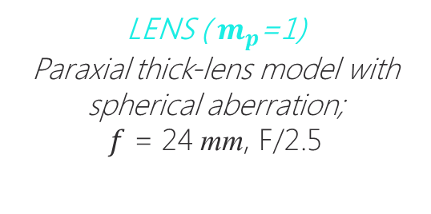
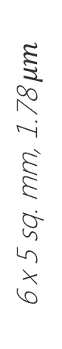
Simulation
Image stack
LENS ( $m_{p}$=1)
Paraxial thick-lens model with spherical aberration;
$f$ = 24 mm, F/2.5
64 mm
$z$-axis
SENSOR PLANE
6 x 5 sq. mm, 1.78 $μm$
89 mm
13 tilts
between -8° & +8°
200 mm
200 mm
1000 mm

Slide 29

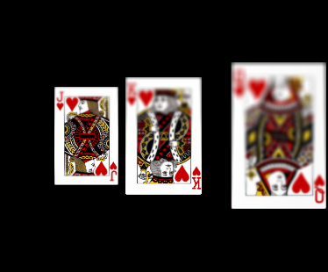
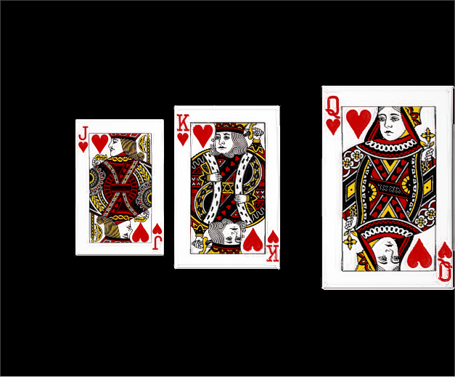
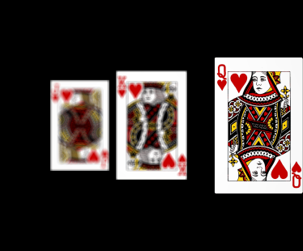
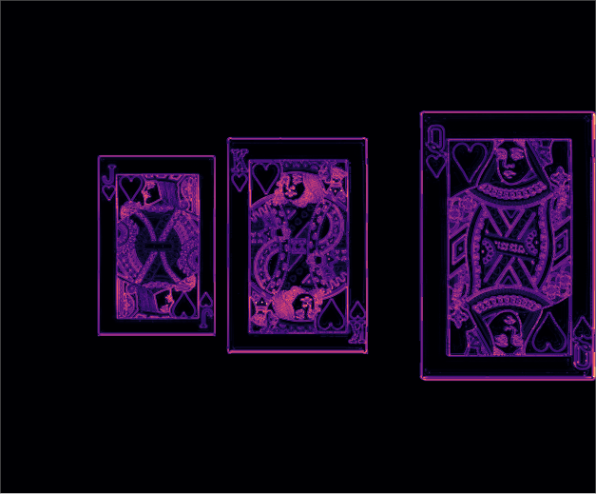

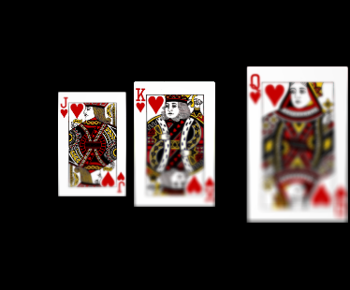

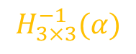



Simulation
Registration
Blending
Composite image
$$H_{3×3}^{−1}(α)$$
1/2
$$⋮$$
$$⋮$$
Focus measure (LoG)
$$⋮$$
$$⋮$$
1/2
$$H_{3×3}^{−1}(α)$$

Slide 30

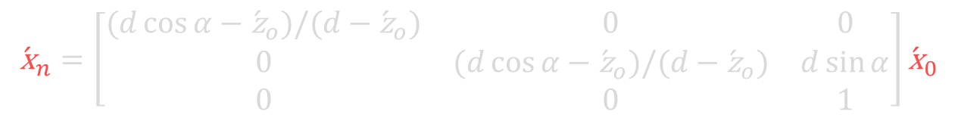
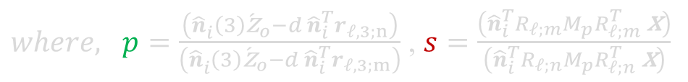
Model
Geometric relation of world point and image point
$$\begin{aligned}{}_{ }^{I}{\acute{\text{x}}}=&{R_{i}^{T}}^{ }\left({\acute{d}}_{e} r_{𝓁,3}−t_{i}\right)&+\frac{\left({\hat{n}}_{i}\left(3\right){\acute{z}}_{o}−{\acute{d}}_{e}{\hat{n}}_{i}^{T} r_{𝓁,3}\right)}{{\hat{n}}_{i}^{T}{}_{ }^{ }{R_{𝓁}}M_{p}{R_{𝓁}^{T}}^{ }\left({}_{ }^{c}{\text{x}}−d_{e} r_{𝓁,3}\right)}{}_{ }^{ }{{R_{i}^{T}}^{ }R_{𝓁}}M_{p}{R_{𝓁}^{T}}^{ }\left({}_{ }^{c}{\text{x}}−d_{e} r_{𝓁,3}\right) \\ \end{aligned}$$
Inter-image homography under lens tilts about the entrance pupil
$$\begin{aligned}{\acute{\text{x}}}_{n}=&\left[\begin{aligned}&{}_{ }^{ }{p s R_{𝓁;n}}M_{p}{R_{𝓁;n}^{T}}^{ }{}_{ }^{ }{R_{𝓁;m}}M_{p}^{−1}{R_{𝓁;m}^{T}}^{ }+\frac{d}{{\hat{n}}_{i}^{ }(3){\acute{\text{z}}}_{o}}\left(r_{𝓁,3;n}−{}_{ }^{ }{p s R_{𝓁;n}}M_{p}{R_{𝓁;n}^{T}}^{ }{}_{ }^{ }{R_{𝓁;m}}M_{p}^{−1}{R_{𝓁;m}^{T}}^{ }\right){\hat{n}}_{i}^{T} \\ & \end{aligned}\right]{\acute{\text{x}}}_{m} \\ & \end{aligned}$$
$where, p=\frac{\left({\hat{n}}_{i}^{ }\left(3\right){\acute{\text{z}}}_{o}−d{ \hat{n}}_{i}^{T}r_{𝓁,3;n}\right)}{\left({\hat{n}}_{i}^{ }\left(3\right){\acute{\text{z}}}_{o}−d{ \hat{n}}_{i}^{T}r_{𝓁,3;m}\right)}$ , $s=\frac{\left({\hat{n}}_{i}^{T}R_{𝓁;m}M_{p}{R_{𝓁;m}^{T}}^{ }\text{x}\right)}{\left({\hat{n}}_{i}^{T}R_{𝓁;n}M_{p}{R_{𝓁;n}^{T}}^{ }\text{x}\right)}$
If pupil magnification, $m_{p}=1$, the inter-image homography reduces to
$$\begin{aligned}{\acute{\text{x}}}_{n}=\left[\begin{matrix}(d\cos{α}−{\acute{\text{z}}}_{o})/(d−{\acute{\text{z}}}_{o}) & 0 & 0 \\ 0 & (d\cos{α}−{\acute{\text{z}}}_{o})/(d−{\acute{\text{z}}}_{o}) & d\sin{α} \\ 0 & 0 & 1\end{matrix}\right]{\acute{\text{x}}}_{0} \\ & \end{aligned}$$

Slide 31





Additional information
For more details (including reproducible code & IPython notebooks) please visit
We have used the following tools for the simulations and figures
Zemax OpticStudio – for ray tracing and image simulation.
PyZDDE – Python Zemax DDE toolbox for automation.
Python Scientific libraries – NumPy, Matplotlib & h5py.

Slide 32
Captioning text

Slide 34
Proposed method
Can we rotate the lens about any point?
Many possible points of rotation
Notes:
Our model shows that there are two important factors to consider for rotating the lens …..
Out the several possible pivot points, is there any particular point that is most desirable?
Is there any
The lens can be tilted pivoted about various points? Is there any preferred pivot position? Talk about the image distortions and consequence of pupil magnification. Also briefly state what is the pupil magnification.

Slide 35
Proposed method
Can we rotate the lens about any point?
Is there any desired lens parameter?
Many possible points of rotation
Notes:
Our model shows that there are two important factors to consider for rotating the lens …..
Out the several possible pivot points, is there any particular point that is most desirable?
Is there any
The lens can be tilted pivoted about various points? Is there any preferred pivot position? Talk about the image distortions and consequence of pupil magnification. Also briefly state what is the pupil magnification.

